Slide 1
PROJECT:
MANAGEMENT OF EMPLOYEE ABSENTEEISM
COMPLETED BY: MANDAR MALEWAR
MENTORED BY: SHARAYOO DIXIT

Slide 2
INTRODUCTION
Joseph, a proficient data analyst at a thriving business ABC.Inc., has been assigned to examine a comprehensive dataset of employee absenteeism to discern trends and patterns. However, the extensive data and the complexity of employee behavior present difficulties in manually deriving significant insights.
By utilizing data analytics, Joseph aims to understand absenteeism patterns and how factors such as age, education level, workload, and target achievements influence it. He intends to conduct a deep analysis of the causes for absenteeism to highlight the most common reasons and any seasonal trends. Moreover, with predictive analysis, he plans to forecast the duration of an employee's absence factoring in elements like the reason for absence, workload, and past absence history.
Help Joseph to analyze employee absenteeism data.

Slide 3
OBJECTIVES
Objective 1- To analyze an Employee Absenteeism dataset to understand various aspects of employee absence, identify patterns and reasons, and predict future absenteeism. This will in turn aid in optimizing workforce management, boosting productivity, and creating a more efficient work environment for employees.
Objective 2- To extract actionable insights from the provided data, concentrating on key areas such as absenteeism patterns across various demographics, frequent reasons for absences, predicting the duration of absence, and identifying employees at risk of high absenteeism.
Objective 3- To clean the dataset, summarize the key findings and draw final business conclusions.

Slide 4
PROJECT REQUIREMENTS
Data Preprocessing and Cleaning
Understanding Absenteeism Patterns
Analyzing Reasons for Absenteeism
Predicting Absenteeism
Identifying Employees at Risk of Absenteeism
Grouping Employees with Similar Absenteeism Patterns
Writing individual interpretation for each task

Slide 5
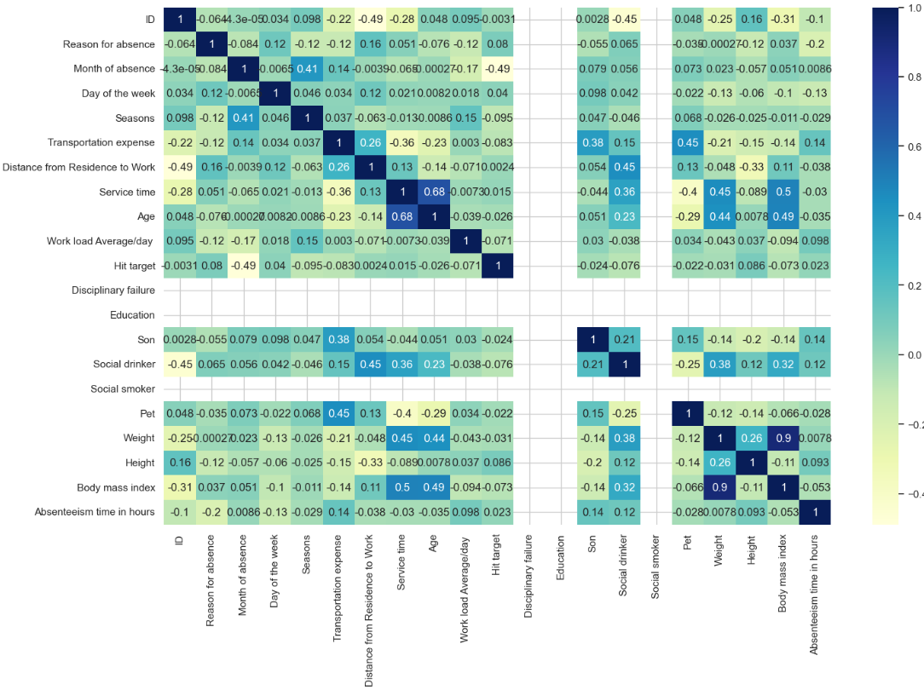
FINDINGS FROM ANALYSIS #1
Correlation heatmap shows high multicollinearity between independent features (Weight and Body mass index)

Slide 6
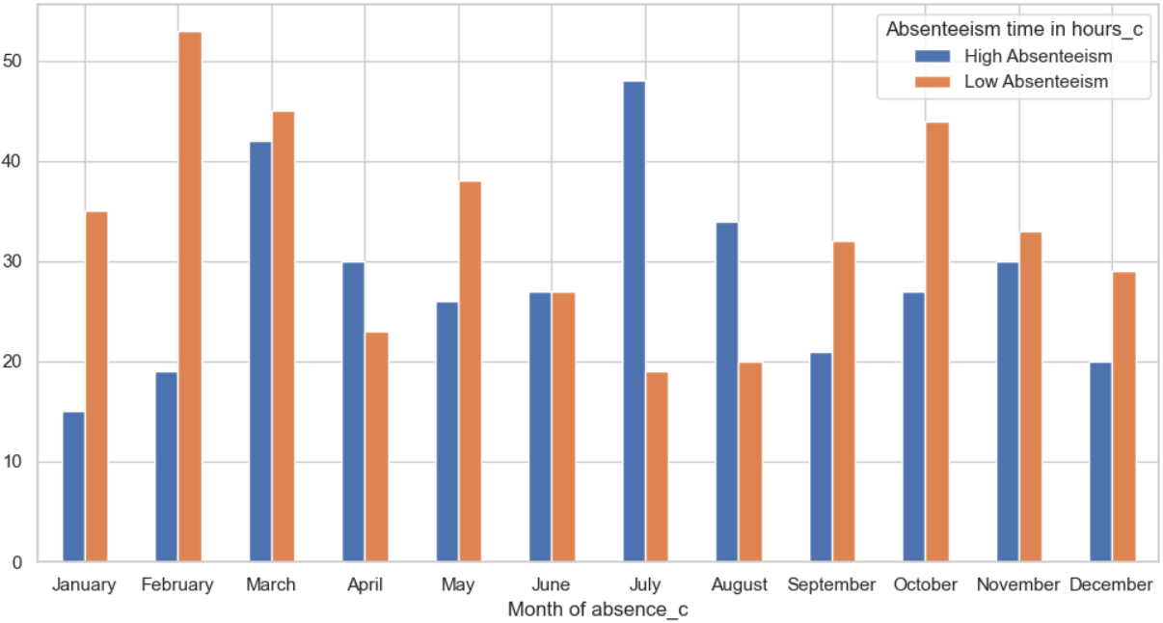
FINDINGS FROM ANALYSIS #2
Month of July has shown very high absenteeism followed by March.

Slide 7
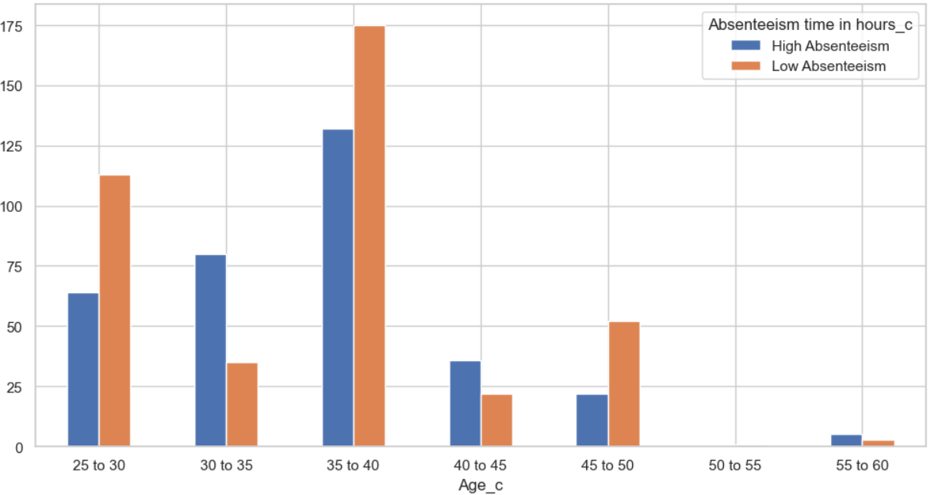
FINDINGS FROM ANALYSIS #3
Employees in the age group of 35 to 40 have the highest total number of hours of absence.

Slide 8
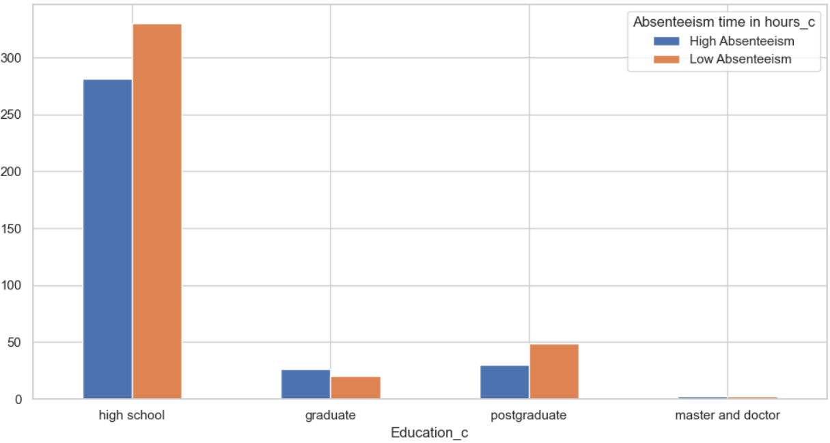
FINDINGS FROM ANALYSIS #4
Employees with high school education have the highest total number of hours of absence.

Slide 9
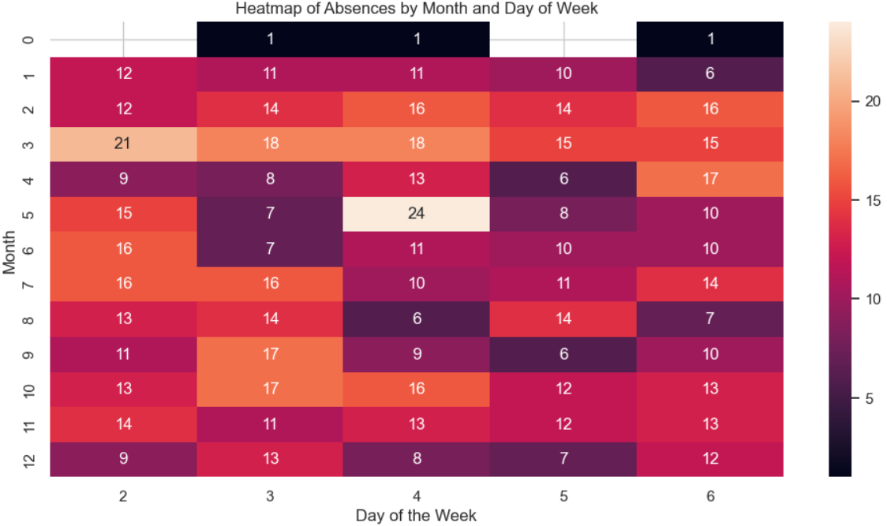
FINDINGS FROM ANALYSIS #5
Absenteeism among employees is highest on Wednesdays of May and Mondays of March months.

Slide 10
SUMMARY
1. Reason for highest total number of hours of absence is blood donation followed by dental consultation.
2. Month of July has shown very high absenteeism followed by March.
3. Employees in the age group of 35 to 40 have the highest total number of hours of absence.
4. Around 40-45 employees with disciplinary failures have shown low absenteeism.
5. Employees with high school education have the highest total number of hours of absence.
6. Employees who are social drinkers have shown highest total number of hours of absence.
7. There are around 50 employees who are social smokers who have been absent.
8. Employees who have not achieved their targets show higher number of hours of absence.
9. Top 3 reasons for absence are blood donation, dental consultation and Diseases of genitourinary system.
10. Absenteeism among employees increases and peaks in the end of the first quarter (March).
11. Absenteeism among employees is highest on Mondays until Wednesday.
12. Absenteeism among employees is highest on Wednesdays of May and Mondays of March months.

Slide 11
BUSINESS CONCLUSIONS
1. We observe a fairly even spread of residuals both above and below the zero line across all indices, so there is some evidence of homoscedasticity. Error distribution curve does not show normality in nature.
2. Multiple linear regression model shows low error with no improvement over Two-Variable model.
3. Multiple linear regression model using Son and Transportation expense features shows slightly better performance compared to a potential single-variable model using only Son.
4. Logistic regression model's accuracy seems very high, and the high recall and F1-score reveal perfection in identifying absenteeism of employees.
5. Logistic regression model's precision of 0.9655 suggests that the model mostly flags all true low absenteeism of employees, and doesn't generate any false positives.
6. While almost perfect, a score of 0.9988 on the ROC curve of logistic regression model indicates great ability to distinguish between high and low absenteeism of employees.

Slide 12
BUSINESS CONCLUSIONS
7. Optimum K value derived from the error-rate plot is 7 for KNN classification model.
8. KNN classification model scores (accuracy, recall, precision, F1-score, and ROC AUC) are high (around 0.85-0.95) suggests that the model performs very well in both identifying relevant cases (recall) and making accurate positive predictions (precision).
9. The highest value of Silhouette Score is at K=10, but selecting K=5 as it is more ideal and odd for K-means clustering model.
10. K-means clustering model is very average at predicting absenteeism patterns.

Slide 13
Thank you!

